Slide 1
SOLAR INVERTER
A solar inverter or photovoltaic (PV) inverter is a type of power inverter that converts the variable direct current (DC) output of a photovoltaic solar panel into a utility frequency alternating current (AC) that can be fed into a commercial electrical grid or used by a local, off-grid electrical network

Slide 2
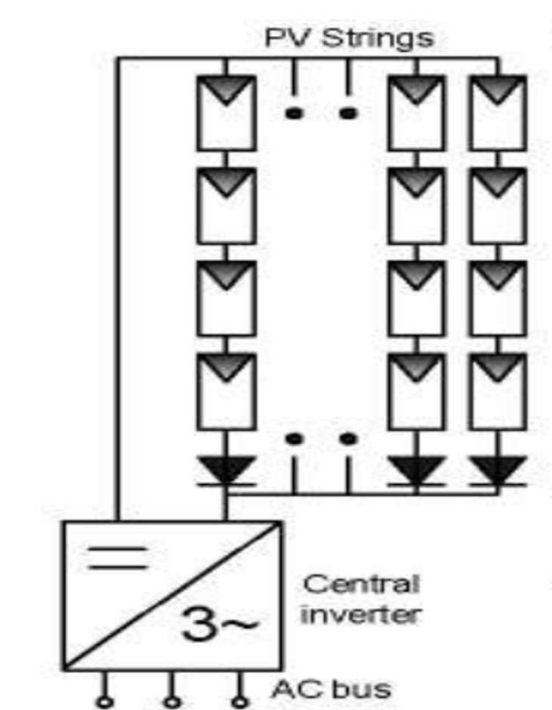
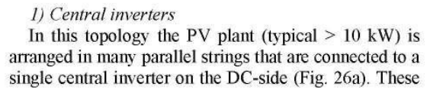
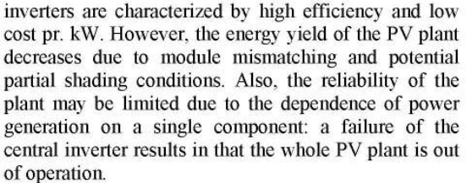
STRUCTURE OF PV INVERTERS

Slide 3
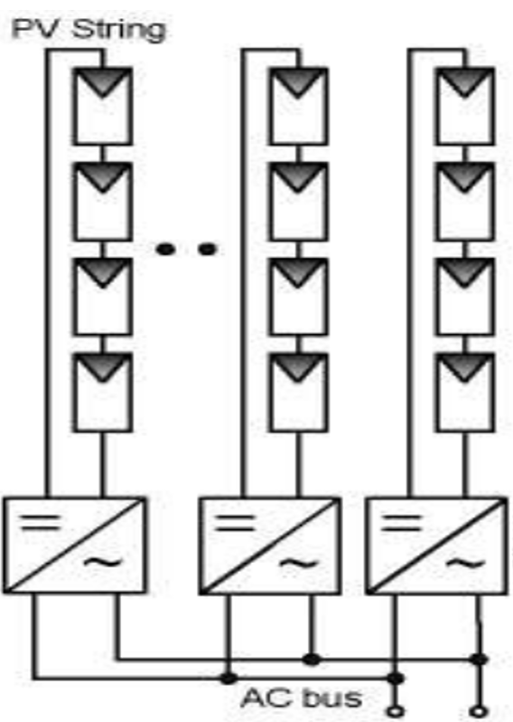
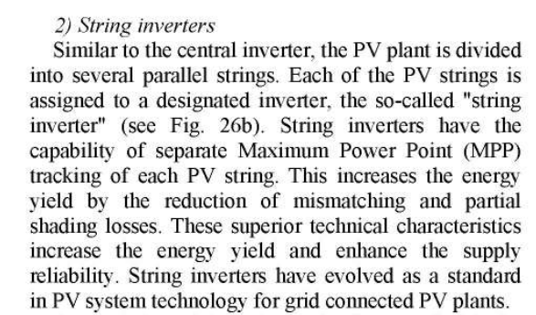
STRUCTURE OF PV INVERTERS

Slide 4
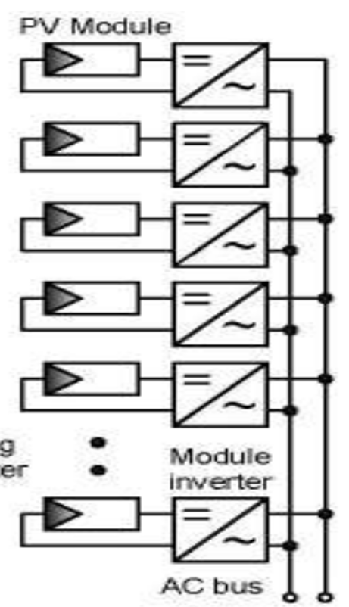
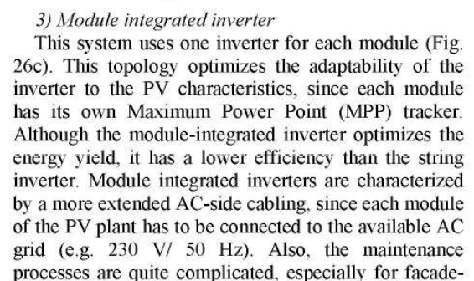
STRUCTURE OF PV INVERTERS

Slide 5
Type of Inverter | Typical Size | Where Used | Key Advantage | Key Limitation
Central | 50 kW – MW | Utility-scale solar farms | Low cost per watt | Whole system affected by shading/mismatch
String | 1–20 kW | Residential & commercial rooftops | Good performance, flexible | Higher cost than central
Microinverter (Module-integrated) | 200–400 W per module | Shaded/complex rooftops | Maximum energy harvest | Expensive

